Slide 1

COMP6200 Data Science Group Project
Group-K
Karthik Varma Keerthipati (46272496)
Utkash Nandakumaran Menon (46169377)
Bilal Qureshi (46119043)
Muhammad Bilal Arif (46142754)

Slide 2
An Introduction to the Project.
Over the last couple of months the world has been in a turmoil due to the spread of COVID-19.
While the whole world is bogged down by the negative aspects of COVID-19, we wanted to analyze the positives of the lockdown.
The most significant positive impact of COVID-19 was that people reported clearer skies and improvement in the weather in various countries around the world.

Slide 3
The Problem Statement
Finding the effect of the lockdown on the impact of air quality

Slide 4
The Data
The data was accumulated from https://discomap.eea.europa.eu/map/fme/AirQualityExport.htm
The data was accumulated for 15 countries that were the most impacted by COVID across Europe.
The data is collected daily and we collected the data for 3 particulates, PM2.5, PM10 and NO₂. This data was collected for 3 years, 2018, 2019 and 2020
The unit of measurement for each gas is (μg/m³).
These 3 particulates were selected as they give a fair estimate for the quality of air.
For the sake of analysis we have split the data into 2 segments, pre lockdown and during lockdown.

Slide 5
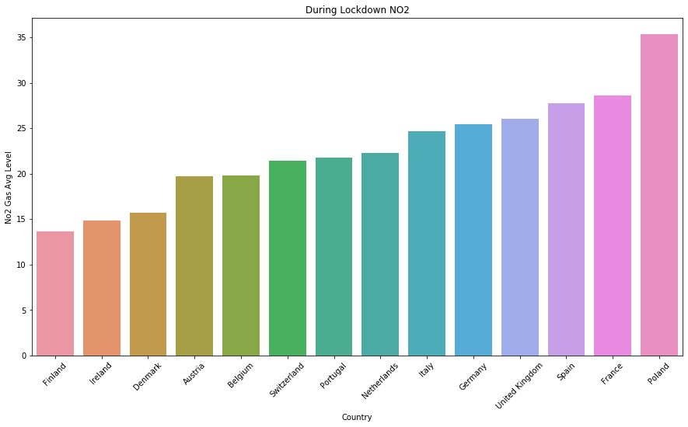
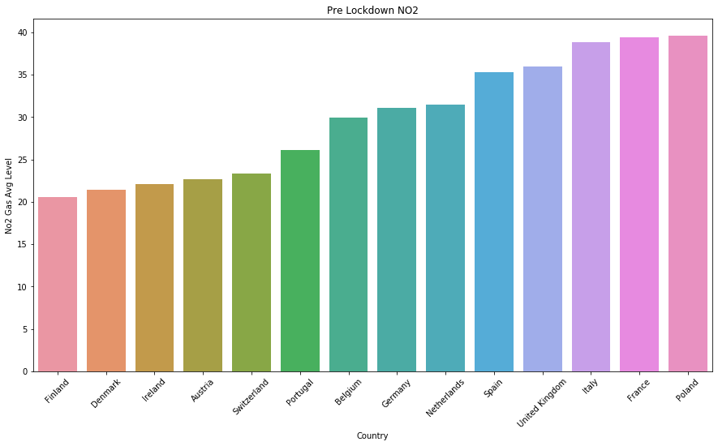
The Data NO₂ Graphs

Slide 6
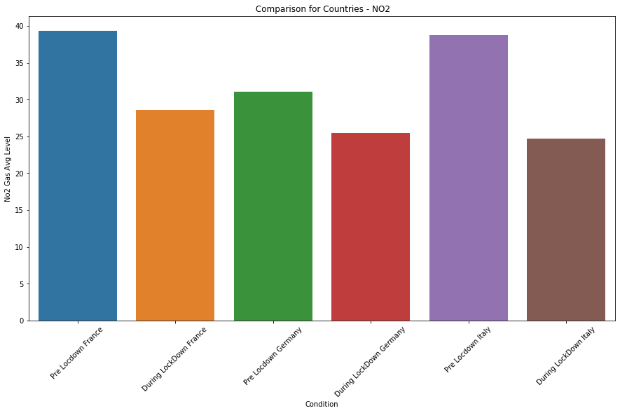
The Data Comparative Graphs NO₂

Slide 7
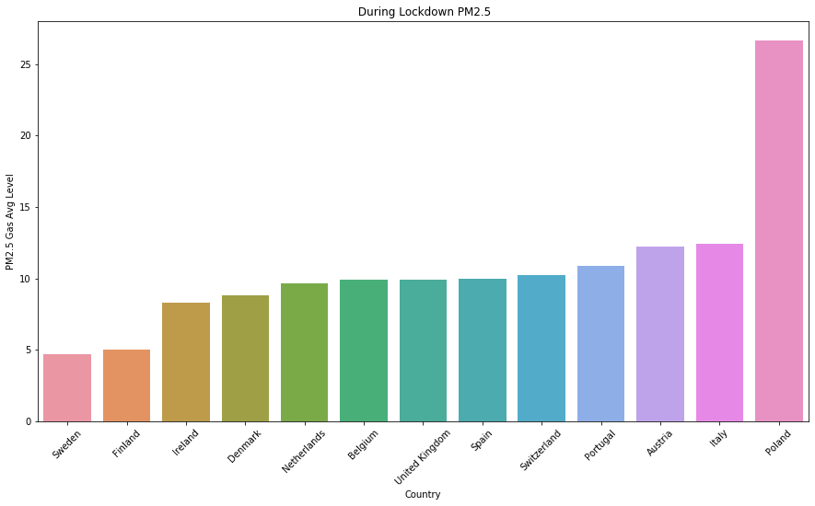
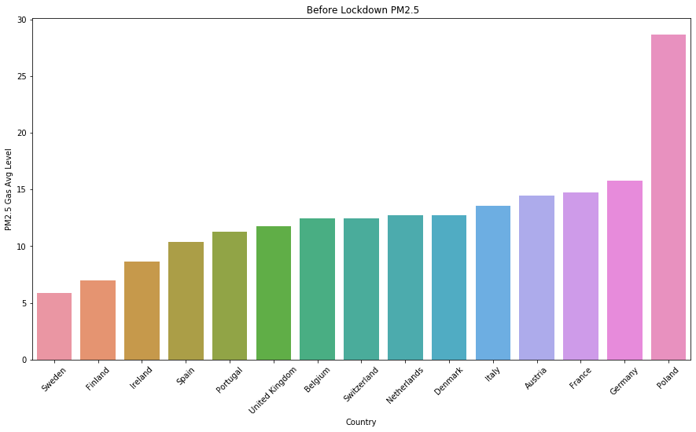
The Data PM 2.5 Graphs

Slide 8
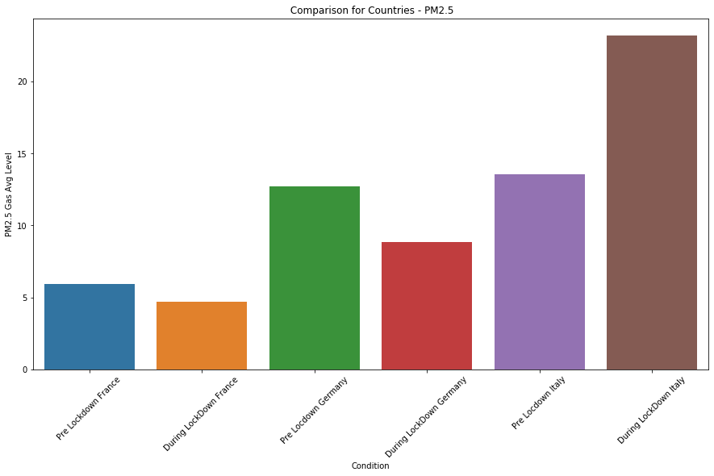
The Data Comparative Graphs PM2.5

Slide 9
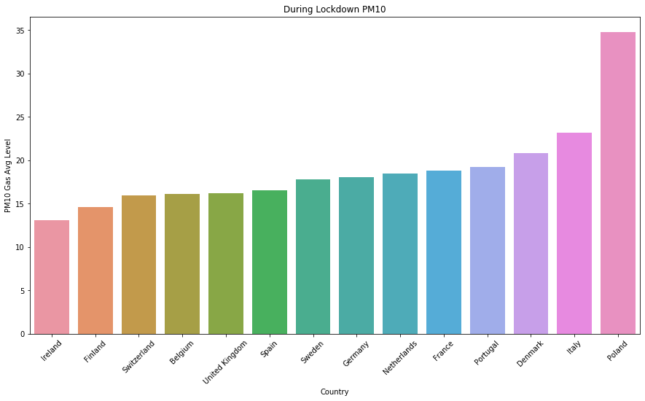
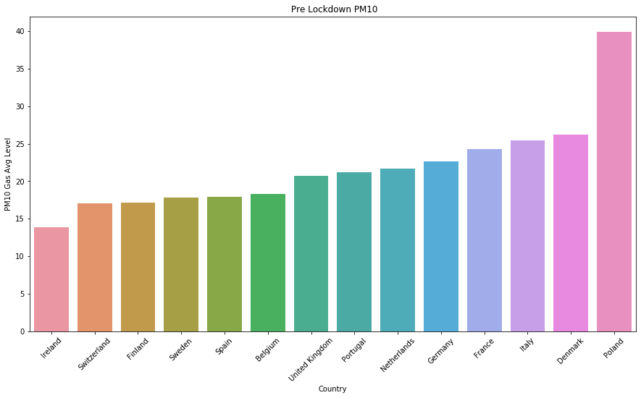
The Data PM10 Graphs

Slide 10
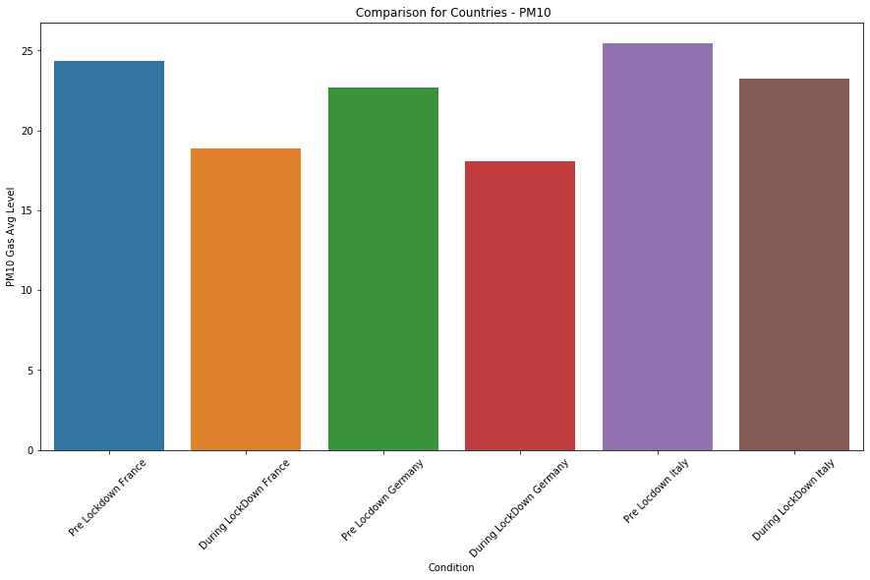
The Data Comparative Graphs PM10

Slide 11
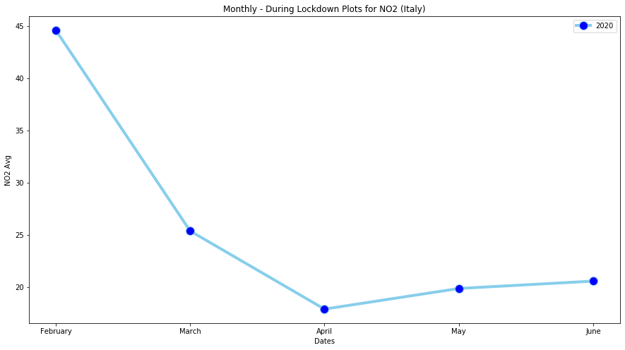
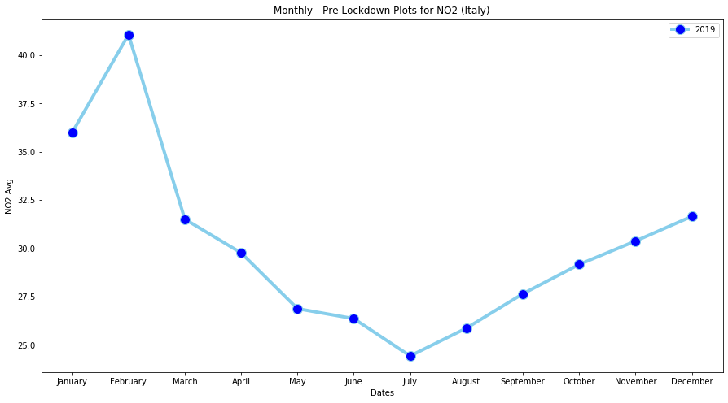
Example: Italy NO₂ Compared Over Time.

Slide 12
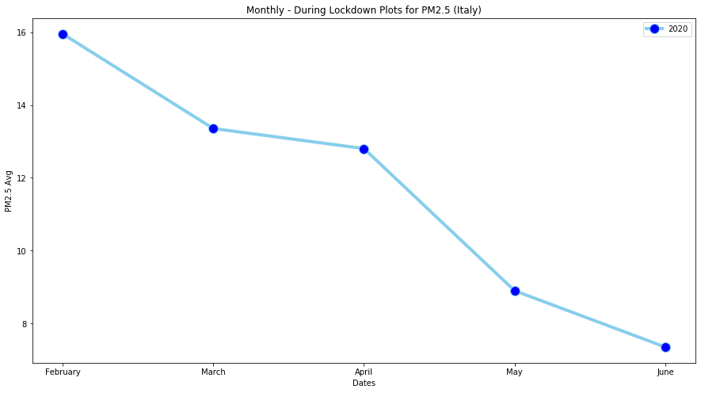
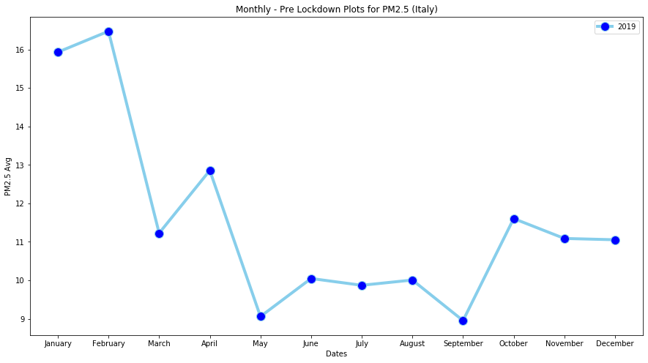
Example: Italy PM2.5 Compared Over Time.

Slide 13
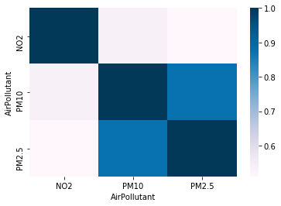
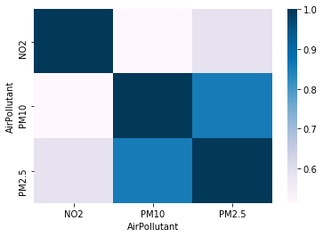
The Data Comparing the Variables.
The following heatmaps represent Pre lockdown and During lockdown values

Slide 14
Prediction of the values Multiple Regression.
We have used multiple regression for the estimation of the future values of PM10 based on the values of PM2.5 and NO₂.
The model uses the following equation:
Y_{i}= x_{i1} +x_{i2}+ x₃+ x₄+ c
We have converted the dates and have used a label encoder to encode the names of the countries to make accurate predictions on the basis of each country.
There were 2 regression models made to analyze the situation during and before lockdown.

Slide 15

Multiple Linear Regression Pre-Lockdown
Upon running the model we can see that the model is fairly accurate:
The regression model performed at 83%.
The model predicted a concentration of 22.9 of PM-1o for Italy on 08-06-2020 and a concentration of 15.58 of PM-10 for Italy on 12-06-2020.

Slide 16

Multiple Linear Regression During Lockdown
Upon running the model we can see that the model accuracy has decreased:
The regression model performed at 78%.
The model predicted a concentration of 24.44 of PM-1o for Italy on 08-06-2020 and a concentration of 17.37 of PM-10 for Italy on 12-06-2020.

Slide 17
Prediction of the Values Multiple Regression For Single Particulates
To make individual analysis, we have considered making models for each particulate.
To do so we used dates and the country names. Each were converted and encoded to simplify the analysis.
There were 6 different models made, 2 for each particulate.
One model was for the data before lockdown and one for during lockdown.

Slide 18


Multiple Linear Regression NO₂
The Model for pre-lockdown showed low accuracy:
The predictions for Italy on 08-06-2020 and 12-06-2020 are 24.54 and 24.50 respectively.
The model for the particulate during lockdown had better R² values:
The predictions for Italy on 08-06-2020 and 12-06-2020 are 13.75 and 13.38 respectively.

Slide 19


Multiple Linear Regression PM10
The Model for pre-lockdown showed extremely low accuracy:
The predictions for Italy on 08-06-2020 and 12-06-2020 are 17.52 and 17.49 respectively.
The model for the particulate during lockdown has extremely low R² values:
The predictions for Italy on 08-06-2020 and 12-06-2020 are 15.94 and 15.81 respectively.

Slide 20


Multiple Linear Regression PM2.5
Yet again the model showed low accurarcy:
The predictions for Italy on 08-06-2020 and 12-06-2020 are 9.64 and 9.62 respectively.
The model for the particulate during lockdown has extremely low R² values:
The predictions for Italy on 08-06-2020 and 12-06-2020 are 7.7 and 7.55 respectively.

Slide 21
Prediction of Variables ARIMA
Since we have used a time series data, there can be a fair amount of seasonality in the values.
For this we only took Italy as a specific case.
We are making estimates for PM-10.
The values are segregated based on months for all the years.

Slide 22
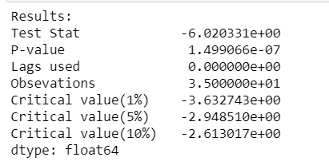
ARIMA
On running the ADF test we get the following results:
The important aspect is that the p-value<<0.05

Slide 23
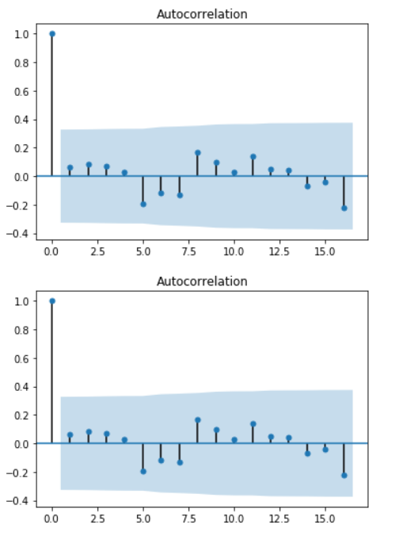
ARIMA

Slide 24
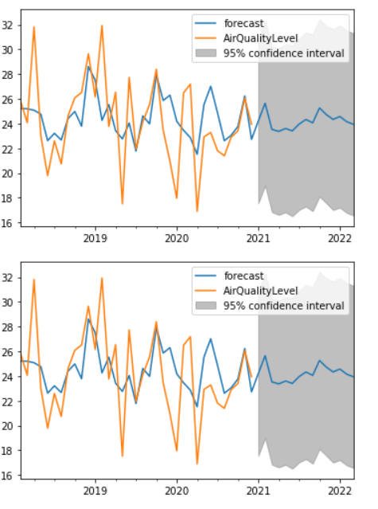
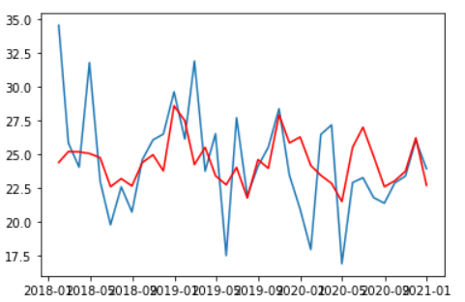
ARIMA

Slide 25

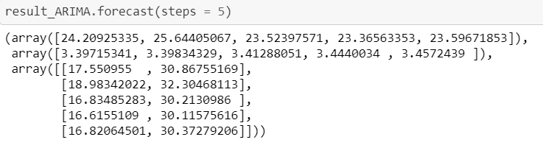
ARIMA
The model seems fairly accurate, given the following values for measures of accuracy:
The model predicted the following values for the next 5 months:

Slide 26
Conclusion
The multiple linear regression for PM-10 as the dependent variable against the other particulates show a higher R² value as compared to the other models.
The models for individual particulates show a lower accuracy but the predictions are more grounded to reality.
The ARIMA model seems to be a good fit but the values seem to converge towards the mean in the future.

